Slide 1
GROUP-1
VOICE TO VOICE: RECOGNITION AND RESPONSE SYNTHESISER
presented by:
Naeem Hadiq (4)
Neha Parveen (6)
Nibras Nazar (7)
Sumeena Salam (50)
Guided by:
Dr. Sobin C. C.
Associate Professor
Department of Computer Science and Engineering

Slide 2
OUTLINE
Introduction
Existing system
Proposed System
System architecture
Algorithm design
Database design
Data flow diagram
Conclusion
Reference

Slide 3
Speech recognition
•Speech recognition is the ability of a machine or program to identify words and phrases in spoken language and convert them to a machine-readable format.

Slide 4
Disadvantages
•Background Noise Interference
•Time Costs and Productivity
•Accents and Speech Recognition
•Requires large amounts of memory
•Requires each user to train software to recognize voice
Notes:
To get the best out of voice recognition software, you need a quiet environment. Systems don't work so well if there is a lot of background noise. They may not be able to differentiate between your speech, other people talking and other ambient noise, leading to transcription mix-ups and errors
Time more for training data
You might think that computerizing a process speeds it up, but this isn't necessarily true of voice recognition systems, and you may have to invest more time than you expected into the process. You'll have to factor in time to review and edit to correct errors. Some programs adapt to your voice and speech patterns over time; this may slow down your workflow until the program is up to speed. You'll also have to learn how to use the system. For example, you must find the right pace and tone -- if you talk too fast or indistinctly, you'll increase spelling and grammar errors. Getting used to using a system's commands and speaking punctuation out loud is not always easy. This can affect the flow and speed of your speech.
To store data sets
To familiarise with our slang or accent we might need to train for each user

Slide 5
OUTLINE
Introduction
Existing system
Proposed System
Design
Conclusion
Reference

Slide 6
METHODS USED IN EXISTING SYSTEM
Acoustic model
Automatic Speech Recognition (ASR)
Support Vector Machine(SVM)

Slide 7
DISADVANTAGES OF EXISTING SYSTEM
Doesn’t support Spontaneous Speech recognition.
May have more WER (Word Error Rate) than other models.
The database used is a limited vocabulary.
Cannot be applied to task involving variable length data classification

Slide 8
System Layout

Slide 9
OUTLINE
Introduction
Existing system
Proposed System
Design
Conclusion
Reference

Slide 10
OUTLINE
Introduction
Existing system
Proposed System
Design
Conclusion
Reference

Slide 11
SYSTEM REQUIRMENTS
Training Core I7 Processor Tesla GPU Multi microphone Array Speaker System 16GB Ram 1TB Storage | End Product Raspberry Pi Multi microphone array TPU(Intel Movidius) Power Supply 3GB Storage Cooling System for PI

Slide 12
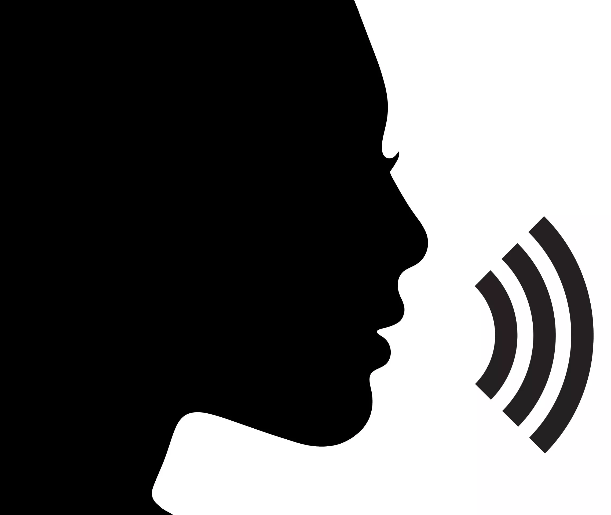

Detailed System Layout
Always on multi Microphone
Stereo Speakers

Slide 13
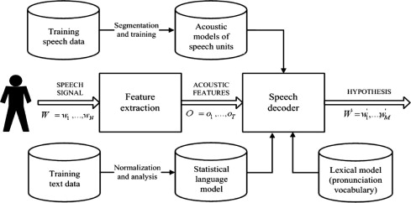
SPEECH TO TEXT MODEL
Utterance based model

Slide 14
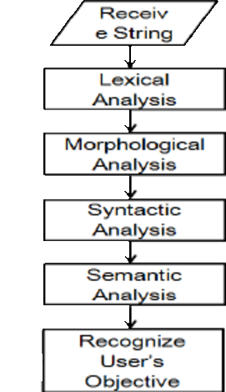
Query Analyser
STT MODEL
Json code
Action initiation/Response generation

Slide 15

Response generator
Action
Or
Response
Json Input
Action Analysis
Response generation from db info
Perform Action
Pass String Output
Pass Confirmative String Output
Text to Voice System

Slide 16
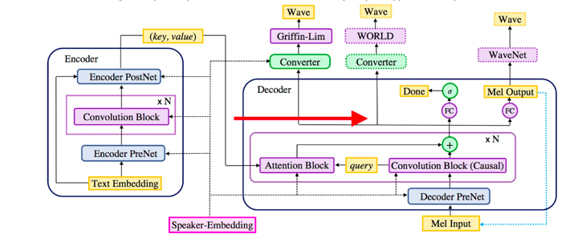
TEXT TO VOICE SYSTEM
Ping, Wei, et al. "Deep voice 3: Scaling text-to-speech with convolutional sequence learning." (2018).
Notes:
The encoder network (depicted in Fig. 1) begins with an embedding layer, which converts characters or phonemes into trainable vector representations, he.These embeddings are first projected via a fully-connected layer from the embedding dimension to a target dimensionality.extract time-dependent text information
The decoder (depicted in Fig. 1) generates audio in an autoregressive manner by predicting a group of r future audio frames conditioned on the past audio frames. Since the decoder is autoregressive, it must use causal convolution blocks.
Griffin-Lim vocoder: Griffin-Lim algorithm converts spectrograms to time-domain audio waveforms by iteratively estimating the unknown phases.
WORLD vocoder: The WORLD vocoder is based on (Morise et al., 2016). As vocoder parameters, we predict a boolean value (whether the current frame is voiced or unvoiced), an F0 value (if the frame is voiced)
WaveNet vocoder: We separately train a WaveNet to be used as a vocoder treating mel- scale log-magnitude spectrograms as vocoder parameters.

Slide 17
OUTLINE
Introduction
Existing system
Proposed System
Design
Conclusion
Reference

Slide 18
Conclusion
We propose a system where the input is taken and processed through a GMM with RNN Network then the output is processed by a Query processing system based on NLP
The output generated is then processed through the deepspeech model to generate output speech

Slide 19
OUTLINE
Introduction
Existing system
Proposed System
Design
Conclusion
Reference

Slide 20
References
[1] “Anusuya, M. A., and Shriniwas K. Katti. "Speech recognition by machine, a review." arXiv preprintarXiv:1001.2267 (2010).Khilari, Prachi, and V. P. Bhope. "A review on speech to text conversion methods." International Journal of Advanced Research in Computer Engineering & Technology 4.7 (2015).
[2] “ Application of prosody modiﬁcation for Speech Recognition in different Emotion conditions”,V. V. Vidyadhara Raju, P. Gangamohan, Suryakanth V Gangashetty, and Anil kumar Vuppala
[3] R.K.Moore, “Twenty things we still don t know about speech” Proc.CRIM/ FORWISS Workshop on Progress and Prospects of speech Research an Technology , 1994.
[4] Hannun, Awni, et al. "Deep speech: Scaling up end-to-end speech recognition." arXiv preprint arXiv:1412.5567 (2014).
[5] Ping, Wei, et al. "Deep voice 3: Scaling text-to-speech with convolutional sequence learning." (2018)

Slide 21
Any Queries?

Slide 22
Thank You

